Slide 1
Auction System Based On Blockchain

Slide 2
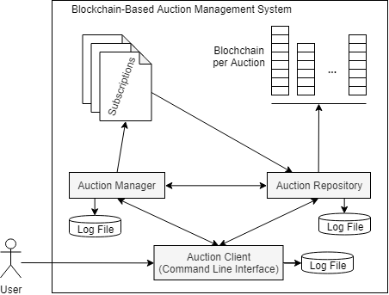
High Level Architecture

Slide 3
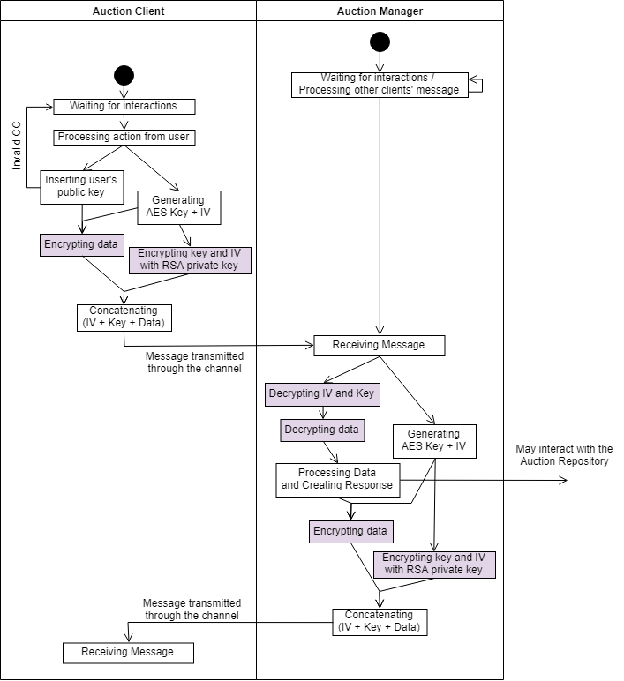
Messages
Messages

